Slide 1

COMPUTING SCIENCE - GRADED UNIT 2
Graded Unit 2 - Overview

Slide 2
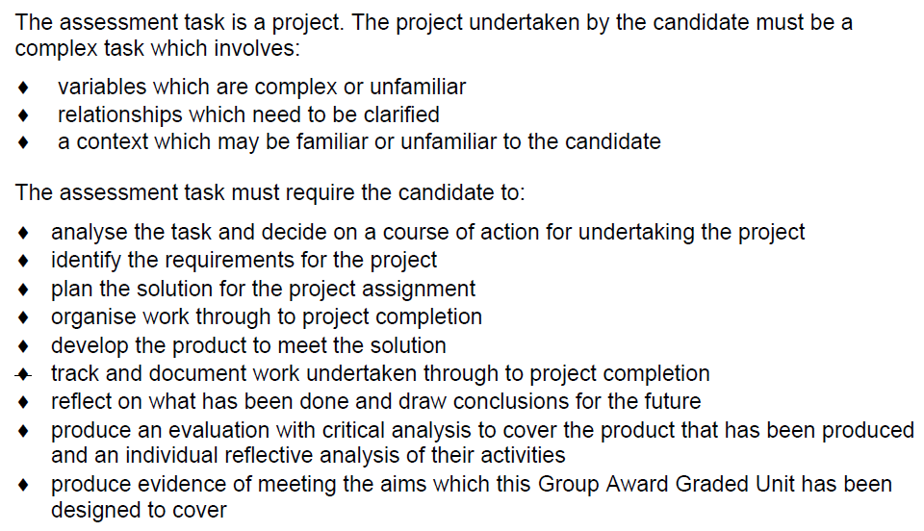
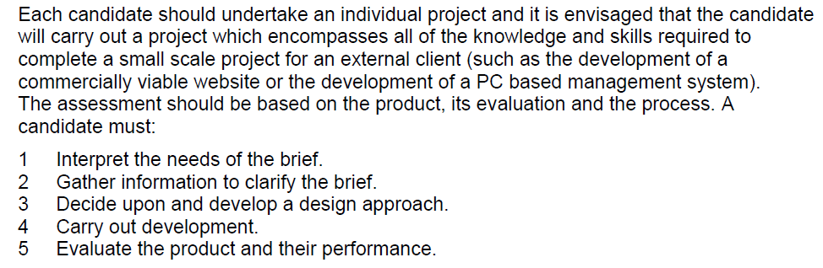
What does it involve

Slide 3
What does it involve

Slide 4
Project
The Graded Unit assessment has a total of 100 possible marks
You will be assigned a Project brief for a small shop
Planning Stage - 40 marks
Development Stage - 40 marks
Evaluation Stage - 20 marks
A minimum of 50% marks must be achieved in each section to achieve a pass

Slide 5
Lecturer Input
The assessor’s role is as a facilitator and so to gain high marks the candidate must demonstrate a high degree of autonomy in the planning, developing and evaluating activities.
This project is your project
The lecturer will:
Guide on tasks
Provide Deadlines for Stages
Advise
Suggest paths / options
Give small amounts of help (during class)
The lecturer WON’T:
Write your code
Troubleshoot your app line by line
Chase you for work - this is your job

Slide 6
Planning Stage
Your assigned project brief will give you information about the company + some sample data
But that’s all!
Your first task – starting today – is to think up questions you’d need to ask to clarify exactly what needs to be built
You “ask” the customer these questions.
In reality, you send them to me, and I answer them

Slide 7
Planning Stage Marks
Planning Stage - 40 marks
Planning report - 30 marks
Project plan - 10 marks

Slide 8
Planning Stage - Detailed Marks Breakdown
An analysis of the Project Assignment Brief
— up to 30 marks
Interpretation of the project brief including any information gathered to clarify the brief
Aims of the project assignment
Requirements: e.g. functional/non-functional/constraints
Identification of the key factors influencing the project
Identification of resources, and materials required and how they will be accessed/obtained
Identification of information sources to be used
Undertaking the analysis using appropriate techniques

Slide 9
Planning Stage - Detailed Marks Breakdown
Project plan
— up to 10 marks
Production of a detailed formal plan to undertake the project with realistic timescales and identifying:
Timescales/schedules for each stage and overall completion
Milestones and deliverables
Main tasks
Resources required

Slide 10
Developing Stage Marks
Development Stage - 40 marks
Implementing the solution - 30 marks
Testing - 8 marks
Managing the project - 2 marks

Slide 11
Development Stage - Detailed Marks Breakdown
Implementing the planned solution to the task — up to 30 marks
Design
Data Analysis of the system (Normalisation, ERD + Class diagram)
UML Design of the system (Activity Diagram)
Coding
Coding of the problem domain
Coding of the UI domain
Use of unfamiliar libraries and/or constructs
Error handling
Internal Documentation

Slide 12
Development Stage - Detailed Marks Breakdown
Testing the implemented solution tracking any changes and making amendments where required
— up to 8 marks
Test Cases Describing Test Purposes
Completed Test Scripts with Test Steps, Data, Expected + Actual Results
Managing the project
— up to 2 marks
Account of deviations from planned Project Schedule

Slide 13
Evaluation Stage Marks
Evaluation Stage - 20 marks
Evaluation report - 20 marks

Slide 14
Evaluation Stage - Detailed Marks Breakdown
Evidence should be in the form of a report showing the evaluation of the effectiveness of the approach/strategy taken, which includes all stages of the activity
— up to 20 marks
An outline of the assignment and to what extent the solution met the original requirements of the assignment brief
An assessment of the strengths and weaknesses of the outputs of the practical assignment
Recommendations for any future development of the solution and reasons for these recommendations
A summary of any modifications to the project plan, solution design and/or implementation, that were made during the project. Including reference to any unforeseen events and how they were handled.
Identification of any knowledge and skills which have been gained or developed while carrying out the project assignment and how the actions/process

Slide 15
Project Grades
The project will be marked out of 100
Grades are final
Students are not able to find out individual marks breakdown
Total Percent per Unit | Final Grade
70% - 100% | A
60% - 69% | B
50% - 59% | C

Slide 16
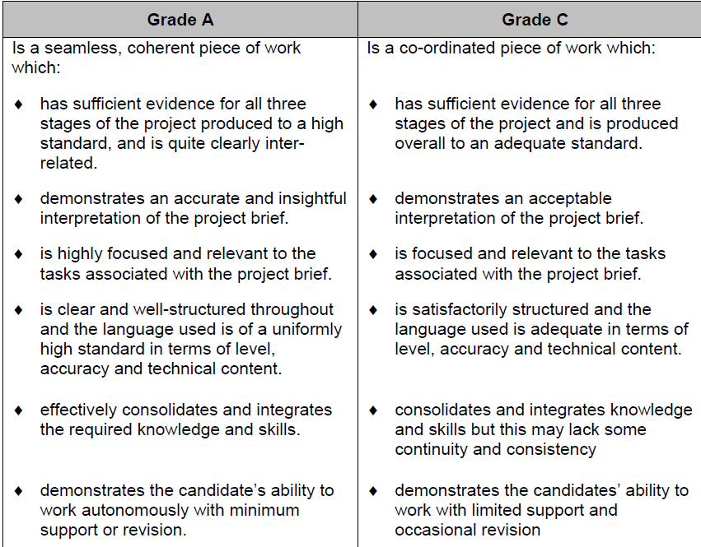
Grading

Slide 17
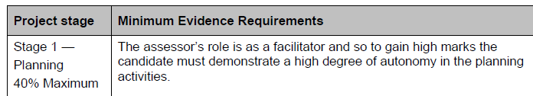
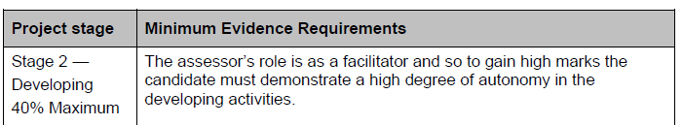
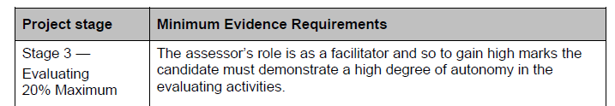
Lecturer Input - Again
The assessor’s role is as a facilitator and so to gain high marks the candidate must demonstrate a high degree of autonomy in the planning, developing and evaluating activities.
This project is your project
This is stated on the SQA unit spec for each of the 3 sections:
That shows you how critical this message is!

Slide 18
Java or C#?
There is absolutely no difference in terms of:
The quality of project you can create
The marks you can get – both get the same marks for the same tasks
The solution you need to make
(i.e. your brief can be made as a C# website OR a Java Forms App – regardless of what the text says)
So which to choose?
Ultimately your choice
The one you are best at should be the one you choose
Don’t choose one just because you’ve heard its better
Or because your friend is choosing it
Choose one because you know you are most comfortable with it!
However I will also be advising
I have asked James / Dana for advice about your progress on both units
You may disagree with my / our advice if you wish
But from years of experience…it’s not a good idea!

Slide 19
Are You Ready?
Definitely! All teaching has been done
Everything you’ve been taught this last 2 years has been to prepare you to do this
You know how to write reports (you’ve done tons)
You know how to create design diagrams (you’ve made millions)
You know how to normalise and produce an ERD (how many times???)
Java Shop? You already have one!
MVC? Tons of examples to use!
You know how to document the testing evidence (Multiplatform + OOP!!)
You’re ready!
This unit is not evil
I’ve shown you how easy it is to get high marks by doing really well in the planning section!
However…
Writing is important. You can’t ignore it. You can’t put it off. You can’t hand in lazy or sloppy work
(if you want to do well that is)
So, if you hate writing… you’ll need to find a way to get over that for the next 18 weeks

